Slide 1
Predicting Car Accident Severity

Slide 2
Introduction/Business
More than 3,000 people die every day in the world, as a result of traffic accidents.
The World Health Organization (WHO) qualifies the situation of traffic accidents as a priority public health problem throughout the world.
In this proyect will build a model to predict the severity of an accident.
Interested:
Drivers are interested in knowing the probabilities of a traffic accident to choose a better route, be careful when driving or postpone their trip.
Responsible for transport in each country, to better understand the contributing factors and the relationships between them in order to introduce specific awareness campaigns and programs to reduce collision.

Slide 3
Data acquisition and cleaning
Dataset called Data-Collisions.csv from the Seattle Department of Transportation for the period between 1st January 2004 and 20th May 2020.
This data set contain a total of 194,673 collision incidents with 37 attribute.
Dropped variables with many missing values and variables that do not add value
Dropped row with missing values.
Cleaned data contain a total of 182,895 collision incidents with
15 attribute

Slide 4
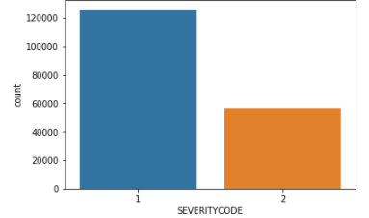
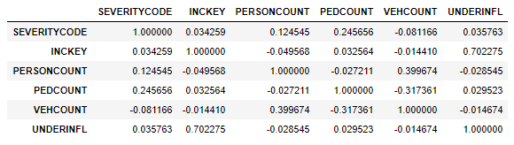
Exploratory Data Analysis
TARGET VARIABLE: The vast majority of accidents involve "property damage only collision" (1), and only a 1/3 of accidents involve "injury collision“.
CORRELATION: not found correlation between variables numerical

Slide 5
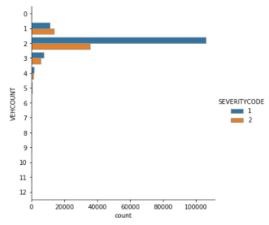
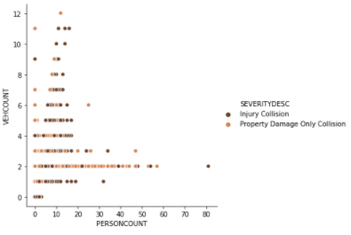
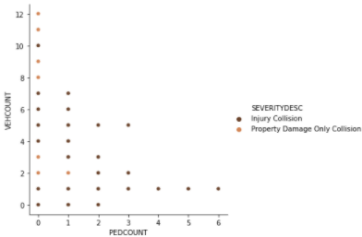
Exploratory Data Analysis –Numerical variables
High relationship between the number of accidents and the number of cars, it was decided to use the variable VEHCOUNT. At the same time high relationship between:
Number of cars and people in the car, PERSONCOUNT discarted
Number of cars and pedestrians PEDCOUNT discarted

Slide 6
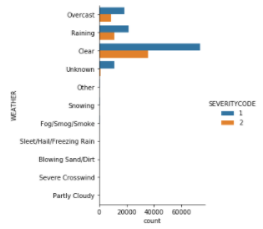
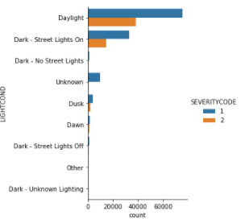
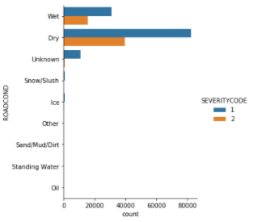
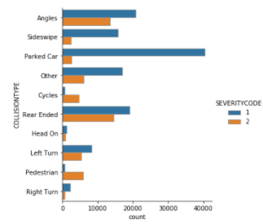
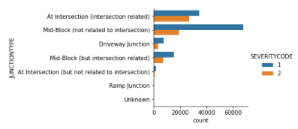
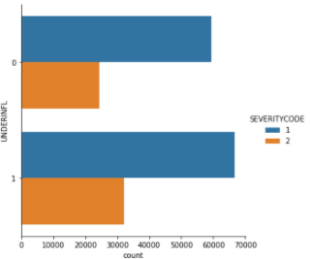
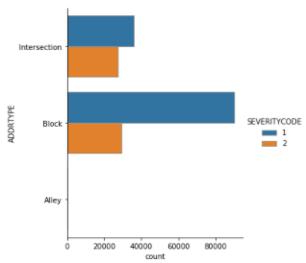
Exploratory Data Analysis –Categorical Variables
Used in models:
WEATHER,
ROADCOND,
LIGHTCOND,
ADDRTYPE
JUNCTIONTYPE

Slide 7
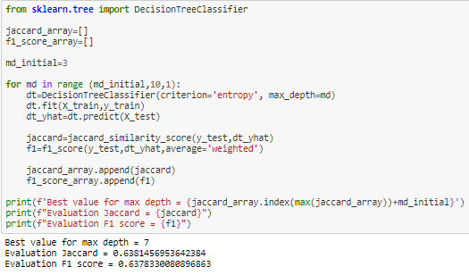
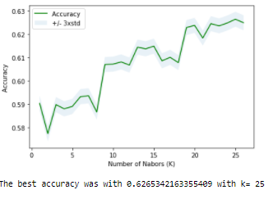
Machine Learning Models
4 different models:
KNN
Decision tree
SVM
Logistic Regression
KNN and Decision Trees have the deficiency, that it is necessary to find the number of optimal neighbors k and the optimal depth, max_depth, in these cases they are k 25 and max_dept = 7

Slide 8
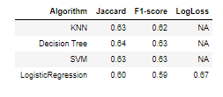
Models Evaluation
Used Jaccard, F1-score and LogLoss for evaluation:
Best model are Decision Tree.
KNN-SVM are Good models too.
The Logistic Regression model performs poorest.Team
In general, decent indices but with high possibility of improving models

Slide 9
Conclusion and future directions
Built useful models to predict accident severity.
The Decision Tree model perform best, with an average F1-score of 0.64 and Jaccard of 0.63
Accuracy of the models has room for improvement.
The best models have Jaccard and F1-score indexes close to 1 and in our case they are approximately 0.63
Revealing hidden patterns in predicting severity in accidents based on the features Weather, Road and Light conditions, addresstype, junctiontype and vehcount.
Another project can start to collect more information from other sources or directly from the roads.

